Slide 1

Bulletin
22nd June 2026
STUDENT
Week B
Attendance
SEND Information
Term Dates
School Policies
Curriculum
Uniform Policy
Friends of OBHS
Catering

Slide 2
Community
 | Mon 22nd June | Tues 23rd June | Weds 24th June | Thurs 25th June | Fri 26th June
Assembly | Wymondham High Year 10 |  | Year 7 and 8 |  | Stem Careers Talk Year 10
Lunchtime Clubs | KS3 Art Club Rm 4 Music & Drama Yellow Tie Rm 35 German Club Rm 36 Allotment Club K Pop Club Rm 30 KS4 Maths Revision Rm 6 Fishing Club Week A only Rm 38 | LGBTQ+ Allies Rm 6 Games Club Rm 22 Y9 Rock Band Rm 30a Y8 Band Rm 30a All Years Cricket MUGA KS3 Homework Club Rm 24 | Maths Ambassadors Rm 6 Y9 Girl Band Rm 30a Music & Drama Green, Red and Blue Tie Rm 35 KS4 GCSE Art Club Rm 4 Y9 and 10 Tennis MUGA Y10 Composition Club Rm30 | DofE Drop in/sessions Rm 6 Choir Rm 30 Y7 and 8 Tennis MUGA KS4 GCSE Art Club Rm 4 Crashing In Gaming Club Rm 15 | Dungeons and Dragons Club Rm 19 All Years Rounders Week B Only Field KS4 GCSE Art Club Rm 4
After School Clubs |  | All Years Cricket (Hard Ball) Field | Interhouse School Rehearsals (until 24th June) 3.30 – 4.30 Rm 30/35 |  | Clay Club Rm 27 5.00 Finish
Events | Year 8 Rounders Match v Long Stratton (Home) Pick up 4.15 | Year 10 Diss Taster Day |  |  | Chapel Green Week A 1.35 Week B 2.00

Slide 3
Community
Keeping Teenagers Safe Online - Bit Defender:
Online safety guidance tends to group all under-18s together, which means it's often too broad to be genuinely useful, especially with teenagers.
Younger children may accept boundaries set by adults without much pushback. Adolescents are different. As they develop their own sense of agency, well-intentioned advice from parents and teachers can quickly become background noise. Getting teenagers to follow online safety guidance is one challenge; getting them to internalise it is quite another.
Bitdefender has published some practical thinking on how to approach this with teenagers specifically. Find out more by following the link below:
https://www.bitdefender.com/en-us/blog/hotforsecurity/how-to-keep-teens-safe-online
Art Summer School:
This is an online Art Summer School run by Norwich University of the Arts that students can take part in as part of their GCSE Art studies. It’s a fantastic opportunity to explore new ideas, experiment with different approaches, and develop your creative skills.
You do not need to complete every session, but if you attend at least three sessions and submit your work, you will receive an attendance certificate. This is a great achievement to include on your CV, sixth form applications, or college applications.
https://norwichuni.ac.uk/courses/info-for-schools/summer-school/
Instrumental lessons;
If your child would like to have instrumental lessons, please ask them to see Miss Fox in room 30.
We currently offer voice, woodwind instruments, guitar, bass, drum kit, keyboard and piano lessons.
If you are interested in another instrument, please let me know and I will try and accommodate this request. If you have pupil premium, lessons are heavily reduced.
Plea from Art:
Any donation of newspapers are very much gratefully received.
PE and Sports Studies Sweatshirts:
GCSE PE and Sports Studies students can order sweatshirts to wear for PE lessons on the following link: https://www.4sportsgroup.com/Old-Buckenham-High-School.

Slide 4

Community
Summer Showcase:
The year 7-10 music auditions will take place on Tuesdays and Wednesday lunchtimes in the music room (30), starting the 19/ 20 May.
Tickets are now on sale from the School Gateway.

Slide 5


Community

Slide 6

Community
Thetford Voices:
Thetford Voices is running a FREE singing workshop on Tuesday 11th and Wednesday 12th August, which may be of interest to our pupils. Over the two days, the children will learn a range of songs on a theme of space, taught and accompanied by professional musicians.
Further details and our sign-up form can be found on their website
www.thetfordvoices.co.uk/upcoming-events-1
Stradbroke Youth Football Club:
​

Slide 7

Ambition
It is Maths Week at OBHS:
We have an assembly with year 10 on Friday with a past pupil to talk about where Maths has led him in his career.
Today all of year 7 will take part in a Maths challenge and we have been looking at careers in Maths during tutor time.
Perhaps you could have a go at one of the Maths challenges attached at home!

Slide 8

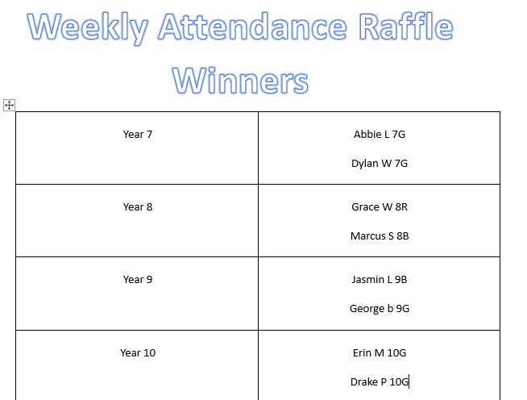
Ambition
Attendance:

Slide 9
Well
Respect
Star of the Week:
Each week we identify a pupil in each year to be our star of the week. This is a simple way for us to recognise our pupils who are really representing our Old Buckenham High School values and making us incredibly proud.
Year 7 | Freya K | 7R | For an exceptional behaviour record since joining the school.
Year 8 | James M | 8G | For earning an impressive 27 positives last week!
Year 9 | Bronte F | 9B | Consistently embracing the school values.
Year 10 | Eve H | 10R | Fantastic work ethic.
​
Other notices:
Plea from Food Tech:
Once again, we are asking for any spare tubs for food tech, and a reminder that all students need to bring their own suitable container for practical lessons.
We have lent out over 60 containers since Christmas and unfortunately, we have now run out. If your child has borrowed a container, please can it be returned asap. Thank you.

