Slide 1

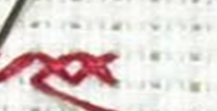
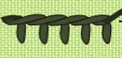
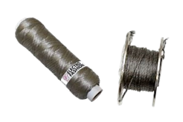
OBHS Core Questions:
Subject: Design and Technology
Year 8
Learn these questions to build a strong foundation of knowledge for this half-term. Ask family or friends to test you regularly, or practise on your own using the ‘Look, Say, Cover, Write’ method
 | Question | Answer
1. | What are the 6R’s of sustainability? | Recycle, reuse, rethink, refuse, reduce, repair
2. | Who is your client? | The person/s you are designing the product for
3. | Which type of stitch is this? | Cross stitch
4. | Which type of stitch do we use when applying an applique patch? | Running stitch
5. | Which type of stitch is this? | Blanket stitch
6. | Which technical textile is used on stab proof vests? | Kevlar
7. | What is the technical textile term for antiseptic dressings? | Microencapsulation
8. | Whose uniform is made from Nomex? | A fire fighter
9. | What is this? | Conductive thread
10. | Which are the two ways we can join timber? | Permanent or temporary
11. | Name three corner joints for timber box construction? | Finger, dovetail, lap, butt,
12. | Which timber joint I used to create a shelf? | Housing
13. | Which timber joint is sanded to a 40 degree angle? | Mitre
14. | Which saw cuts a straight line in timber by hand? | Tenon saw, hand saw
15. | Which saw cuts curves in timber by hand? | Coping saw
16. | Which two other pieces if equipment do we need to saw lap joints other thana tenon saw? | Bench hook, quick release clamp
17. | Name one advantage of using CAD software to design an idea | Can be altered immediately, can be shared, can view before building
18. | Name one disadvantage of using CAD software for designing an idea? | Expensive, you need training on the program
19. | Which clear plastic did we use for the money box fronts? | Acrylic
20. | Name a non-paint type of finish that can be used on timber? | Wax, varnish, stain, oil

